Slide 1
  Radiation Modelling of NORM in Tailings
  to Predict Long-term Radiation Protection
  Clasina Roodt, Principal Radiation Specialist, CRSA
  ARPS – WA 27 March 2025

Slide 2
Are you currently operating or planning a mine or processing plant
Q: Your operation might concentrate radionuclides to levels considered to be radioactive, what do you do if material stays radioactive for centuries?
A: Do NOT allow it to be distributed into the surrounding environment!
Q: What if you have no choice? You might have NORM in tailings facilities
A: You design TSF with the best chance to protect humans & environment in future.
1

Slide 3
When did the regulators get interested in Non-Human Biota (NHB)?
Historic risk assessments have been based on human health only
If humans are protected, so is the environment
2

Slide 4
When did the regulators get interested in Non-Human Biota (NHB)?
Historic risk assessments have been based on human health only
Then: 1999: EPBC Act (Environment Protection & Biodiversity Conservation Act)
If humans are protected, so is the environment
2

Slide 5
When did the regulators get interested in Non-Human Biota (NHB)?
Historic risk assessments have been based on human health only
Then: 1999: EPBC Act (Environment Protection & Biodiversity Conservation Act)
2007: ICRP published a framework for the protection of the environment
(International Commission on Radiological Protection)
If humans are protected, so is the environment
2

Slide 6
When did the regulators get interested in Non-Human Biota (NHB)?
Historic risk assessments have been based on human health only
Then: 1999: EPBC Act (Environment Protection & Biodiversity Conservation Act)
2007: ICRP published a framework for the protection of the environment
(International Commission on Radiological Protection)
2015: ARPANSA followed with the publication RPS, Guide G-1
(Australian Radiation Protection and Nuclear Safety Agency)
If humans are protected, so is the environment
2

Slide 7
But why even bother?
3

Slide 8
But why even bother?
Radiation is one way the Feds can delay your project
3

Slide 9
But why even bother?
Radiation is one way the Feds can delay your project
You need Approval
3

Slide 10
How does radioactivity interest the Federal Government?
> 1 Bq/g
> 1x 10⁶ Bq
Potential requirement for Referral under EPBC Act
Radiation is one way the Feds can delay your project
Considers Matters of National Environmental Significance (MNES)
You need Approval
4

Slide 11
What is the process followed if material triggers a nuclear action?
Radiation Impact Assessment (RIA)
Radiation is one way the Feds can delay your project
Prove NO Significant Impact to Environment (MNES)
You need Approval
5

Slide 12
How do you decide whether to refer or not?
Radiation Impact Assessment (RIA)
Radiation is one way the Feds can delay your project
You need Approval
6

Slide 13
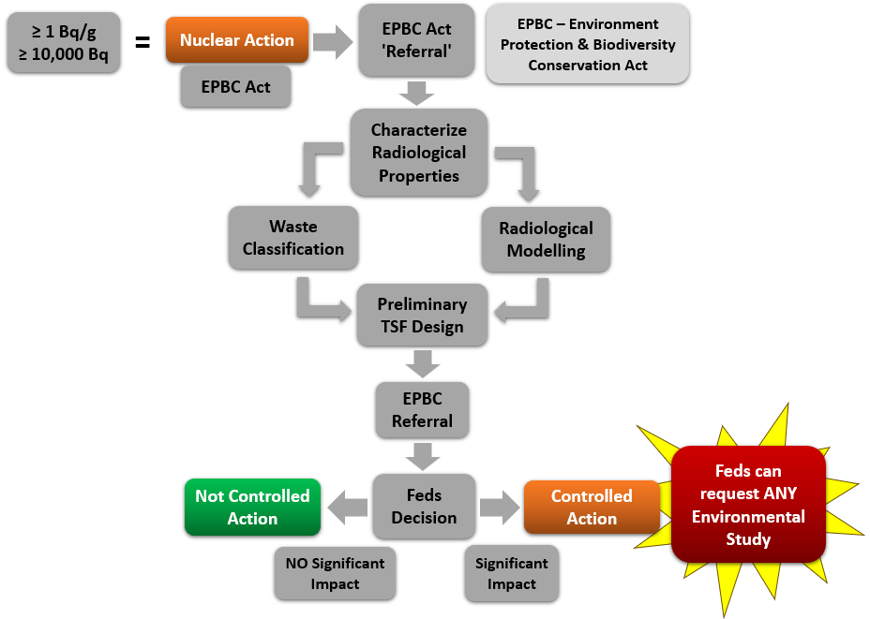
What other ‘approvals’ can be informed from RIA?
Rehabilitation strategies
Mine Closure Plan
Characterise Radiological Properties
Radiation Impact Assessment (RIA)
Closure & Relinquishment
EPA
Contaminated Sites Act
Impact to Environment (MNES) or Human Health
DEMIRS
DWER
Preliminary TSF Design
Radiation Management Plan (RMP)
DCCEEW
DEMIRS
Radiation Waste Management Plan (RWMP)
RCWA
7

Slide 14
How does the RIA fit in with other studies in TSF Design?
8

Slide 15
How do you conduct a Radiation Impact Assessment?
Radiation is one way the Feds can delay your project
Characterise Radiological Properties
Radiation Impact Assessment (RIA)
Waste Classification
Radiological Modelling
Preliminary TSF Design
You need Approval
9

Slide 16
How do you conduct a Radiation Impact Assessment?
> 1 Bq/g
> 1x 10⁶ Bq
Radiation is one way the Feds can delay your project
Characterise Radiological Properties
You need Approval!
10

Slide 17
How do you characterise tailings?
Full Radionuclide Analysis
Leachability Testing
11

Slide 18
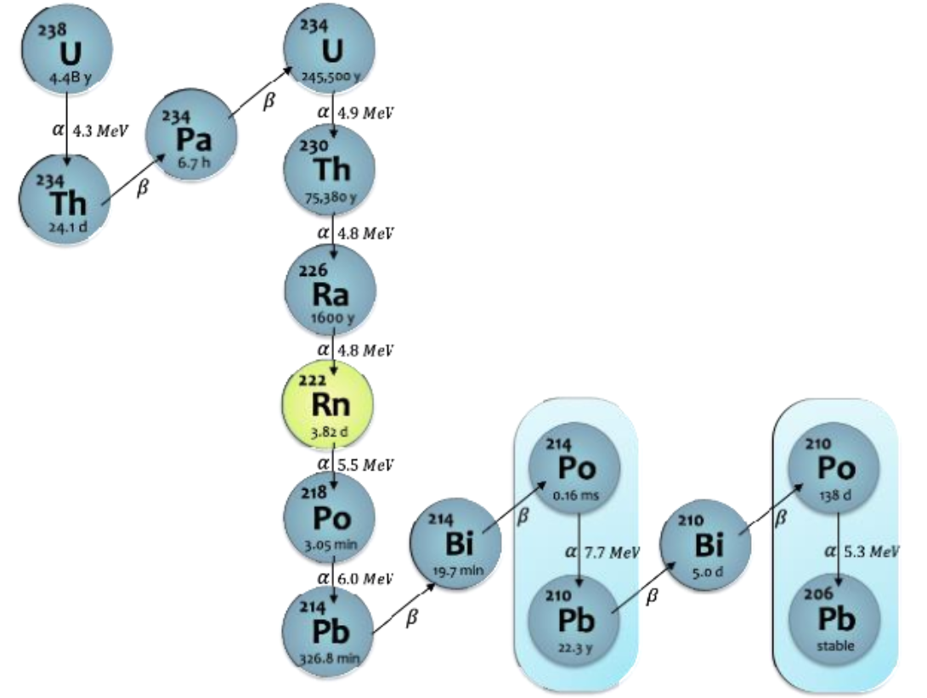
Why do you characterise tailings?
Half-Life
2
Energy of emission
Mobility in environment (Distribution Coefficient, Kd)
3
1
Radio-Toxicity
Exposure Pathways
4
12

Slide 19
Why do you characterise tailings?
13

Slide 20
How do you conduct a Radiation Impact Assessment?
> 1 Bq/g
> 1x 10⁶ Bq
Radiation is one way the Feds can delay your project
Characterise Radiological Properties
Waste Classification
You need Approval!
14

Slide 21
Why do you classify radioactive wastes?
It Determines Facility Type
Engineered
Landfill
Containment & Isolation Requirements
Near Surface
Commercial
Intermediate Depth
Deep Geological Disposal
Industrial
15

Slide 22
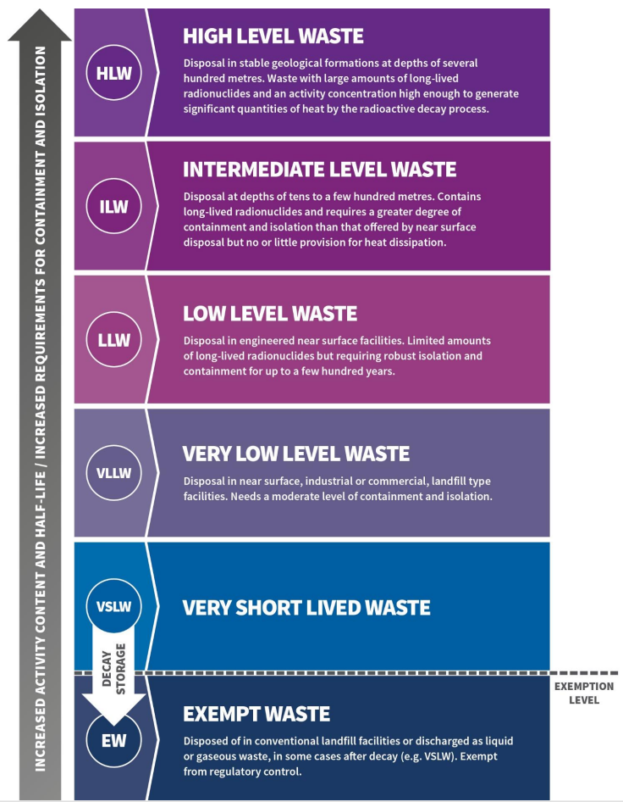
How do you classify radioactive waste?
Guideline
Documents
IAEA
RS-G-1.7
GSR-3
Increased Activity Content & T1/2 / Increased Requirement for Containment & Isolation
GSG-1
ARPANSA
Six classes of radioactive waste illustrate
the relationship between classification,
activity content, half-life,
and disposal options
(Figure from RPS G-4)
RPS G-4
DEMIRS
NORM-4.2
EXEMPTION LEVEL
16

Slide 23
How do you conduct a Radiation Impact Assessment?
> 1 Bq/g
> 1x 10⁶ Bq
Radiation is one way the Feds can delay your project
Characterise Radiological Properties
Waste Classification
Radiological Modelling
You need Approval!
17

Slide 24
Why do you use radiological models?
Predicts behaviour of radionuclides
Evaluates exposure routes & long-term effects
Determines if disposal concepts meet radiological standards
To demonstrates radiation exposure is of no regulatory concern in relation to maintenance of biological diversity,
conservation of species,
health of natural ecosystems,
and to the health of humans
18

Slide 25
RESRAD (RESidual RADioactivity)
Human Health
ERICA (Environmental Risk from Ionising Contaminants Assessment and Management)
Non-Human Biota (NHB)
Which models do you use?
19

Slide 26
RESRAD - Human Health
Developed by Argonne National Laboratory
Flexibility to specific exposure scenarios
Calculates radiation exposure & excess cancer risk
Internationally accepted IAEA 2004, Cheng & Yu, 1993
Why use these models?
20

Slide 27
RESRAD - Human Health
Developed by Argonne National Laboratory
Flexibility to specific exposure scenarios
Calculates radiation exposure & excess cancer risk
Internationally accepted IAEA 2004, Cheng & Yu, 1993
ERICA - Non-Human Biota (NHB)
Developed under European Commission
Flexibility to add user-specific species, concentration ratios (CRs), and occupancies
Calculates radiological risk to Terrestrial, Freshwater, and Marine biota
Internationally accepted
Why use these models?
20

Slide 28
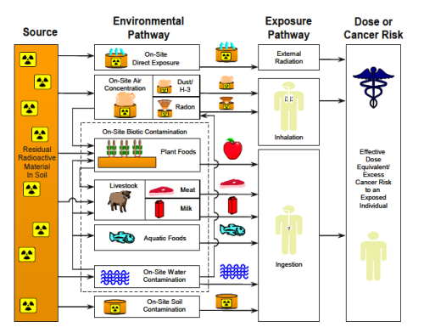
What are the radiological pathways considered in RESRAD?
21

Slide 29
Source releases radiation
What are the radiological pathways considered in RESRAD?
22

Slide 30
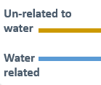
Primary exposure to human receptor
What are the radiological pathways considered in RESRAD?
23

Slide 31
Environmental pathways: Exposure to non-human receptors related to uptake of nuclides in tissue or available to humans thereafter
What are the radiological pathways considered in RESRAD?
24

Slide 32
Secondary exposure to human receptor through food chain
What are the radiological pathways considered in RESRAD?
25

Slide 33
What are the inputs into RESRAD?
26

Slide 34


What are the inputs into RESRAD?
Different Lithologies:
Thickness
Bulk density
Porosity
Field capacity
Hydraulic Conductivity
b Parameter
NORM Material:
Area
Radionuclides
Length // to aquifer flow
Inside or above GW
Hydraulic gradient
Well parameters
27

Slide 35
The ERICA (NHB) integrated approach follows a tiered assessment
Software tool structured on Integrated Approach
Non-Human Biota (NHB) Environmental Assessment
Predicts Risk to Reference Animals & Plants (RAPs)
28

Slide 36
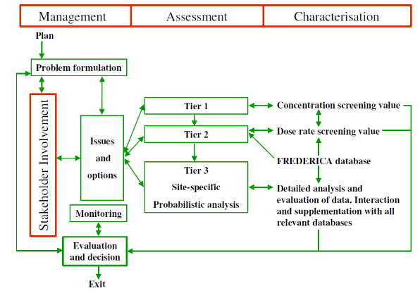
The ERICA (NHB) integrated approach follows a tiered assessment
Software tool structured on Integrated Approach
Environmental Media Concentration Limits (EMCLs)
OK
Exit Assessment
Most limiting organism per nuclide
Tier 1
Not OK
Next Tier
Predicts Risk to Reference Animals & Plants (RAPs)
29

Slide 37
The ERICA (NHB) integrated approach follows a tiered assessment
Software tool structured on Integrated Approach
Note: ~ 15 µGy/h average gamma background
Exit Assessment
<10 µGy/h
Tier 2
OK
Predicts Risk to Reference Animals & Plants (RAPs)
>10 µGy/h
DCRL*
Effects Range
ERL*
Not OK
Next Tier
30

Slide 38
What are Reference Animals & Plants (RAPs) considered in the ERICA Tool?
Freshwater | Marine | Terrestrial
Amphibian (frog) | (Wading) bird (egrets) | Amphibian (frog)
Benthic fish (bottom rovers) | Benthic fish (flat fish) | Bird (duck)
Bird (duck) | Bivalve mollusc (benthic mollusc) | Bird egg (duck egg)
Bivalve mollusc (oyster) | Crustacean (crab) | Detritivorous invertebrate (woodlouse)
Crustacean (prawn) | Macroalgae (brown seaweed) | Flying insects (bee)
Gastropod (slug) | Mammal (whale) | Gastropod (snail)
Insect larvae | Pelagic fish (tuna) | Grasses and herbs (wild grass)
Mammal (rakali) | Phytoplankton (algae and diatoms) | Lichen (symbiotic) and bryophytes (moss)
Pelagic fish (salmonid / trout) | Polychaete worm (benthic worm) | Mammal (rat, deer)
Reptile (pond turtle) | Reptile (sea turtle) | Reptile (snake)
Phytoplankton (algae) | Sea anemones/true coral (colony) | Shrub (wild grass) - Vascular
Vascular plant (water lilies) | Vascular plant (in shallows) | Soil invertebrate (worm / earthworm)
Zooplankton (larval crustaceans) | Zooplankton (krills) | Tree (pine tree) - Vascular
31

Slide 39
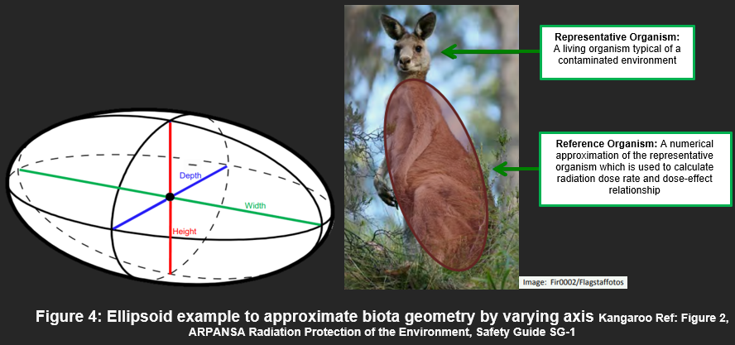
It’s important to consider species geometry when evaluating exposure
32

Slide 40
How do you conduct a Radiation Impact Assessment?
> 1 Bq/g
> 1x 10⁶ Bq
Radiation is one way the Feds can delay your project
Characterise Radiological Properties
Waste Classification
Radiological Modelling
Preliminary TSF Design
You need Approval!
33

Slide 41
How does the RIA assist in your TSF Design?
Characterise Radiological Properties
Waste Classification
Radiological Modelling
Preliminary TSF Design
34

Slide 42
  For more information contact
  Clasina.Roodt@iluka.com

